Slide 1
Binomial Tree
Binomial tree is an ordered tree that can be recursively defined as:
A binomial tree of order 0 has a single node.
A binomial tree of order i has a root node whose children are root nodes of binomial trees of order i-1, i-2, …, 2, 1, 0.
A binomial tree Bi has 2^{i} nodes
The height of a binomial tree Bi is i
Note that binomial tree Bi consist of two binomial trees (of order
B_{i-1}) that are linked together in such a way that the root of one is the leftmost child of the root of the other.

Slide 2
Binomial Queue(Heap)
A binomial queue or binomial heap H is a collection of binomial trees that satisfies the following properties.
Every binomial tree in H satisfies the minimum heap property
There can be one or more binomial trees for each order including zero order.
While the first property tells that the root of a heap-ordered tree contains the smallest key in the tree,
The second property on the other hand implies that a binomial heap H having N nodes contains at most log N + 1 binomial trees.

Slide 3
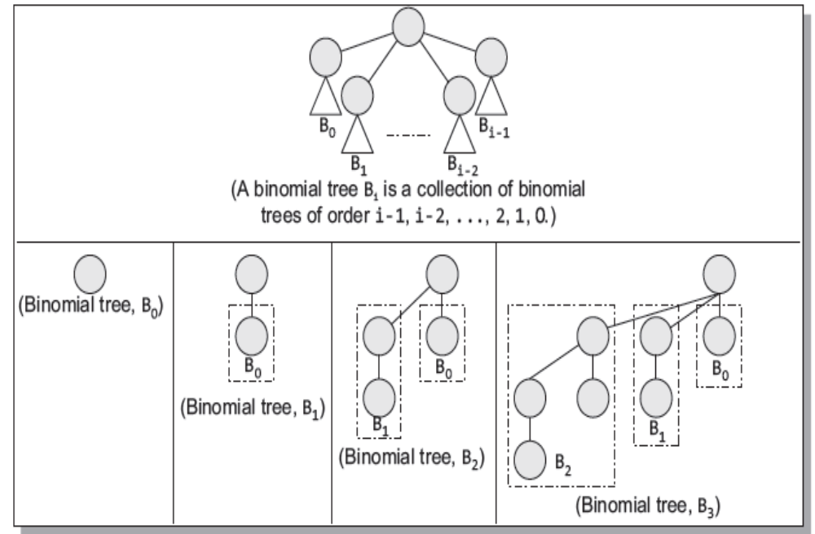

Slide 4
Linked representation of Binomial Heaps in Memory
Each node in a binomial heap H has several fields that stores the values. Each node N has certain pointers like,
P[N] that point to the parent of N
Value[N] that stores the value of N
Child [N] that point to the leftmost child, and
Sibling[N] that point to the sibling of N that is immediately to its right.
Degree[N] that stores the number of children of N.
NOTE: If N is the root node, then P[N] = NULL. If N has no children, then Child[N] = NULL, and if N is the rightmost child of its parent, then sibling[N] = NULL.

Slide 5
Linked representation of Binomial Heaps in Memory
Head [H]
7
9
11
27
10
14
36
16
12
18
21
19
Binary Heap

Slide 6
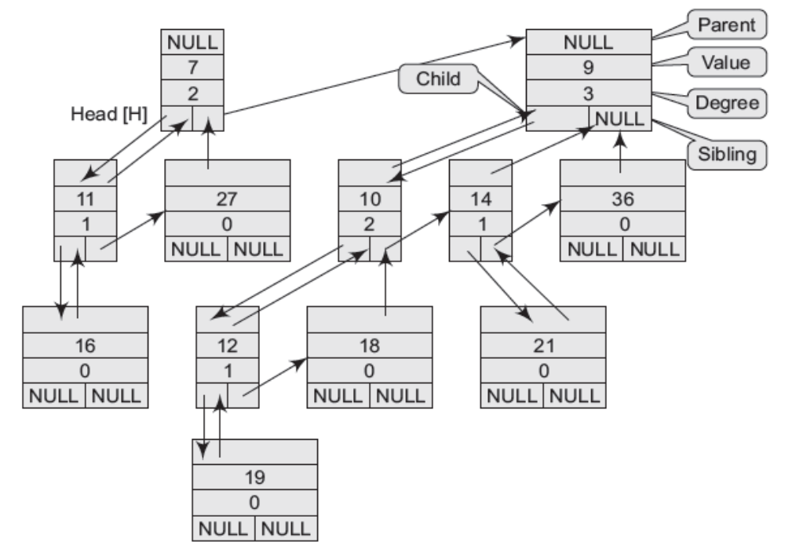
The Linked representation of the Binomial Heap is

Slide 7
Operations on Binomial Heaps
Create a new binomial heap
The procedure Create_Binomial-Heap(), allocates and returns an object H, where Head[H] is set to NULL. The running time of this procedure can be given as O(1).
Finding the minimum key
The procedure Min_Binomial-Heap() returns a pointer to the node having minimum value in the binomial heap H .
A binomial heap is heap-ordered, therefore, the node with minimum value in a particular binomial tree will appear as the root node in the binomial heap. Thus, the Min_Binomial-Heap() procedure checks all roots. Since there are at most log n + 1 roots to check, the running time of this procedure is O(log n).

Slide 8
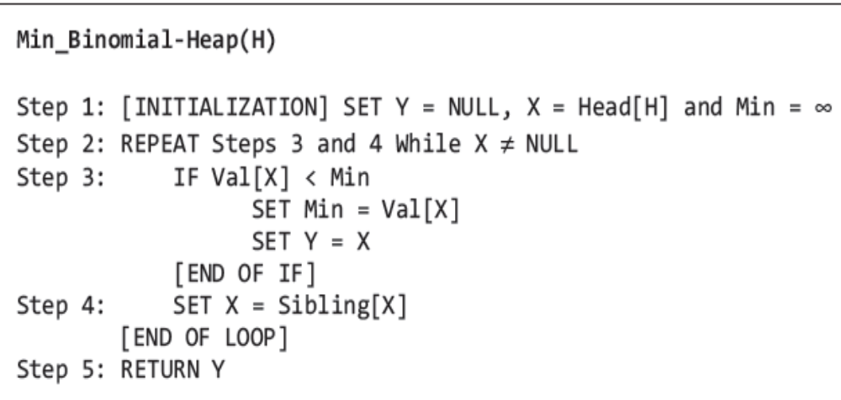
Algorithm to find the node with minimum value

Slide 9
Operations on Binomial Heaps
Consider the Binomial heap given and find the minimum value.
Head [H]
12
7
9
11
27
10
14
36
16
12
18
21
19
X
Head [H]
12
7
9
Min = 12
11
27
10
14
36
16
12
18
21
19

Slide 10
Operations on Binomial Heaps
Y
X
Head [H]
12
7
9
Min = 7
11
27
10
14
36
16
12
18
21
19
Min = 7
Y
X
Head [H]
12
7
9
11
27
10
14
36
16
12
18
21
19

Slide 11
Linking two Binomial Trees
The procedure of uniting two binomial heaps is used as a subroutine by other operations. The Union_Binomial-Heap() links together the binomial trees whose roots have the same degree. The algorithm to link B_{i-1} tree rooted at node Y to the B_{i-1} tree rooted at node Z; making Z the parent of Y can be given as below
Link_Binomial-Tree(Y, Z)
Step 1: SET Parent[Y] = Z
Step 2: SET Sibling[Y} = Child[Z]
Step 3: SET Child[Z] = Y
Step 4: Set Degree[Z] = Degree[Z]+ 1
Step 5: END
The Link_Binomial-Tree()procedure makes Y the new head of the linked list of node Z's children in O(1) time.

Slide 12
Uniting two Binomial Heaps
The algorithm to unite binomial heaps H1 and H2, returning the resulting heap H
Union_Binomial-Heap(H₁, H₂)
Step 1: SET H = Create_Binomial-Heap()
Step 2: SET Head[H] = Merge_Binomial-Heap(H1,H2)
Step 3: Free the memory occupied by H1 and H2
Step 4: If Head[H] = NULL, then RETURN
Step 5: SET PREV = NULL, PTR = Head[H] and NEXT = Sibling[PTR]
Step 6: Repeat Step 7 while NEXT ≠ NULL
Step 7: IF Degree[PTR]≠Degree[NEXT] OR (Sibling[NEXT]≠NULL AND Degree[Sibling[NEXT]] = Degree[PTR]), then
  SET PREV = PTR, PTR = NEXT
  ELSE IF Val[PTR] ≤ Val[NEXT], then
  SET Sibling[PTR] = Sibling[NEXT]
  Link_Binomial-Tree(NEXT, PTR)
  Else
  IF PREV = NULL, then
  Head[H] = NEXT
  ELSE
  Sibling[PREV] = NEXT
Link_Binomial-Tree(PTR, NEXT)
SET PTR = NEXT
SET NEXT = Sibling[PTR]
Step 8: RETURN H

Slide 13
Uniting two Binomial Heaps
The running time of Union_Binomial-Heap() can be given as O(log n), where n is the total number of nodes in binomial heaps H1 and H2. If H1 contain n1 nodes and H2 contain n2 nodes, then H1 contains at most log n1 + 1 roots and H2 contains at most log n2 + 1 roots, so H contains at most log n2 + log n1 + 2 ≤ 2 log n + 2 = O(log n) roots when we call Merge_Binomial-Heap() Since, n = n1 + n2, the Merge_Binomial-Heap() takes O(log n) to execute. Each iteration of the while loop takes O(1) time, and because there are at most log n1 + log n2 + 2 iterations, the total time is thus O(log n).

Slide 14
Unite the Binomial Heaps given below
Head [H₁]
12
7
9
27
10
14
12
Head [H₂]
18
4
8
17
10
14
36
19
29
18
21
12
18
21
31
36
24
19
39

Slide 15
PTR
NEXT
Head [H]
12
18
7
4
9
8
27
19
10
14
17
10
14
36
12
29
18
21
12
18
21
31
36
24
19
39
PTR
NEXT
Head [H]
12
7
4
9
8
18
27
19
10
14
17
10
14
36
12
29
18
12
18
21
21
31
36
24
19
39

Slide 16
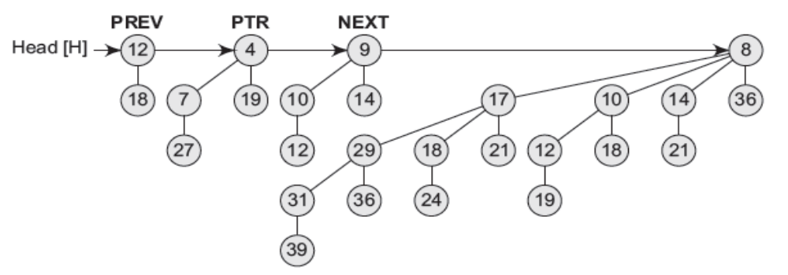
PREV
PTR
NEXT
Head [H]
12
7
4
9
8
18
27
19
10
14
17
10
14
36
12
29
18
21
12
18
21
31
36
24
19
39

Slide 17
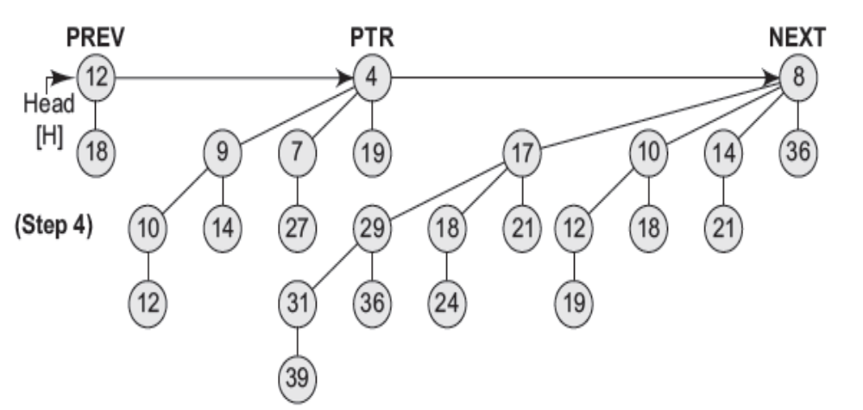

Slide 18
Inserting a new node
The Insert_Binomial-Heap() procedure is used to insert a node x into binomial heap H. The pre-condition of this procedure is that the node x has already been allocated space and val[x] has already been filled in.
Insert_Binomial-Heap()
Step 1: SET H’ = Create_Binomial_Heap()
Step 2: SET Parent[x] = NULL, Child[x] = NULL
Sibling[x] = NULL, Degree[x] = NULL
Step 3: SET Head[H’] = x
Step 4: SET Head[H] = Union_Binomial-Heap(H, H’)
Step 5: END

Slide 19
The algorithm simply makes a binomial heap H' in O(1) time.
H’ contains just one node that is, x.
Finally, the algorithm unites H’ with the n-node binomial heap H in O(1g n) time.
Note that the memory occupied by H’ is freed in the Union_Binomial-Heap(H, H’) procedure.

Slide 20
Extracting the node with minimum key
The algorithm to extract the node with the minimum key from binomial heap H is shown below. The Min-Extract_Binomial-Heap procedure accepts a heap H as a parameter and returns a pointer to the extracted node
Min-Extract_Binomial Heap (H)
Step 1: Find the root R having minimum value in the root list
of H
Step 2: Remove R from the root list of H
Step 3: SET H' = Create_Binomial-Heap()
Step 4: Reverse the order of R's children thereby forming a
linked list
Step 5: Set head[H']to point to the head of the resulting list
Step 6: SET H ₌ Union_Binomial-Heap(H, H’)
Step 7: Return R

Slide 21
Extracting the node with minimum key
Example: Extract the node with minimum value from the binary heap
given below.
Head [H]
18
8
4
19
12
16
5
10
14
36
21
29
18
21
12
18
21
31
36
24
19
39
R
4
Head [H]
18
8
5
10
14
36
19
12
16
29
18
21
12
18
21
21
31
36
24
19
39

Slide 22
Extracting the node with minimum key
Head [H]
18
8
Head [H’]
36
14
10
5
19
12
16
21
12
18
29
18
21
21
19
31
36
24
39
Head [H]
36
14
5
18
21
8
29
18
21
19
10
12
16
31
36
24
12
18
21
39
19

Slide 23
Decreasing the value of a node
The algorithm to decrease the value of a node x in a binomial heap H is given below. In the algorithm the value of the node is overwritten with a new value k, that is of course less than the current value of the node. The Binomial-Heap_Decrease_Val procedure takes O(log n) time as the maximum depth of node x is log n, so the while loop will iterate at most log n times.
Binomial-Heap_Decrease_Val(H, x, k)
Step 1: IF Val[x] < k, then Print “ ERROR”
Step 2: SET Val[x] = k
Step 3: SET PTR = x and PAR = Parent[PTR]
Step 4: Repeat while PAR ≠ NULL and Val[PTR] < Val[PAR]
Step 5: SWAP ( Val[PTR}, Val[PAR] )
Step 6: SET PTR = PAR and PAR = Parent [PTR]
Step 7: END

Slide 24
Deleting a key
Once we have understood the Binomial-Heap_Decrease_Val procedure, it becomes very easy to delete a node x's value from binomial heap H in O(lg n) time. To start with the algorithm we set the value of x to - ∞. Assuming that there is no node in the heap that has a value less than -∞. The algorithm to delete a node from a binomial heap can be given as below.
Binomial-Heap_Delete-Node(H, x)
Step 1: Binomial-Heap_Decrease_Val(H, x, -∞)
Step 2: Min-Extract_Binomial-Heap(H)
Step 3: END

Slide 25
Deleting a key
Example: Delete the node with value 11 from the binomial heap H.
Head [H]
36
14
5
12
21
8
29
18
21
21
10
12
16
31
36
24
11
18
21
39
19
Head [H]
36
14
5
12
21
8
29
18
21
PAR
21
PTR
10
12
16
31
36
24
-∞
18
21
39
19

Slide 26
Deleting a key
(Contd.)
Head [H]
36
14
5
12
21
PAR
8
29
18
21
PTR
21
-∞
12
16
31
36
24
10
18
21
39
19
PAR
Head [H]
36
14
5
12
21
PTR
-∞
29
18
21
21
8
12
16
31
36
24
10
18
21
39
19

Slide 27
Deleting a key
(Contd.)
PTR
Head [H]
36
14
-∞
12
21
5
29
18
21
21
8
12
16
31
36
24
10
18
21
39
19
R
Head [H]
36
14
-∞
12
21
5
29
18
21
21
8
12
16
31
36
24
10
18
21
39
19

Slide 28
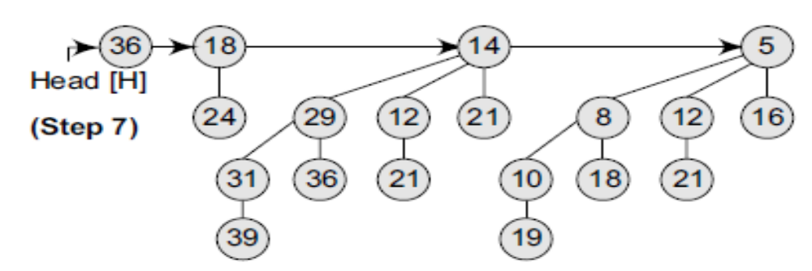
Deleting a key
(Contd.)
Head [H]
36
14
Head [H’]
5
29
18
12
21
8
12
16
31
36
24
10
18
21
39
29
19

Slide 29
Head [H]
36
18
5
24
14
8
12
16
29
12
21
10
18
21
31
36
21
19
39

Slide 30
Comparison between Binary & Binomial Heaps
Operation | Description | Time complexity in Big O Notation
 |  | Binary | Binomial
Create Heap | Creates an empty heap | O(n) | O(n)
Find Min | Find the node with minimum value | O(1) | O(log n)
Delete Min | Delete the node with minimum value | O(log n) | O(log n)
Insert | Insert a new node in the heap | O(log n) | O(log n)
Decrease Value | Decrease the value of a node | O(log n) | O(log n)
Union | Unites two heaps into one | O(n) | O(log n)

